Slide 1
Saigon Newport Corporation (SNP)
The New Normal (Threats and Opportunities)

Slide 2
ENDEMIC PREPARATION
Terminal Readiness to accommodate additional business
Identify the bottleneck of individual terminal
Work on Short, Medium and Long Term solutions.
Productivity Gap, Yard Strategy and Crane Reliability.
2. Equipment Availability
Mid and Long Term plan on improving crane reliability.
Execute the plan in accordance to business plan and potential surge of Volume.
Review the current processes and remapping the meet future business.
Berth Capacity
Yard Capacity
Main Gate Capacity
Manpower
IT

Slide 3
ENDEMIC PREPARATION
Berth Capacity
Yard Capacity
Main Gate Capacity
Manpower
IT
3. Manpower
Review the manpower availability and decide on way forward plan together with COO.
Work on the out scouring if it will ease the situation.
4. Main Gate Capacity
Work on Gate processing time internally.
Engage the customers to truck out Import Containers as per agreed Dwell Time.
Together with Commercial Division determine which are the customers who require additional storage days.
Establish total yard capacity impact Matrix and agreeing on way forward.
5. IT Support
TOS capability to manage surge in volume.
Leverage TOS to further optimize process and reports.

Slide 4
CHALLENGES VS RISK
CHALLENGES
RISK
Surge In Volume
Yard Space Constraint
Import Container Dwell Time
Reshuffling of Import Container due to over stack
T/S Terminal Cargo building up
2. Port Efficiency
Gross Moves Per Hour
Berth Moves Per Hour
Vessel Bunching
Equipment Availability
Cost of rehandles
Carbon Footprint (15%)
Cost Imports and Exports
External Truck Waiting Time
Additional space to move long standing unit

Slide 5
ICT STRATEGY 2014 - 2024
MMC PORTS
ICT STRATEGY 2014-2024
Operating Excellence & Streamlining
Achieving Business Growth & Change
Governance, Standardization & Compliance
Competency & Team Building
RAMCO SYSTEM
SHARED SYSTEM CENTRALIZATION
TERMINAL OPERATING SYSTEM STANDARDIZATION
Notes:
From perspectives of People, Process and Technologies.

Slide 6
EXPERIENCE IN PORT MODERNIZATION HOW JOHOR PORT AND MMC MODERNIZES ITS TERMINALS
IT Digitalization
Asset Digitalization
RTG Optimisation
Marine Resource Management
Labor Management System
ERP
ERP Digital Transformation will provide much-needed efficiency across MMC’s port operations – cost reduction of by 20%
The implementation of a common system and integrated technology platform will further maximise synergies and allow all our ports to share expertise and benefit from economies of scale.

Slide 7
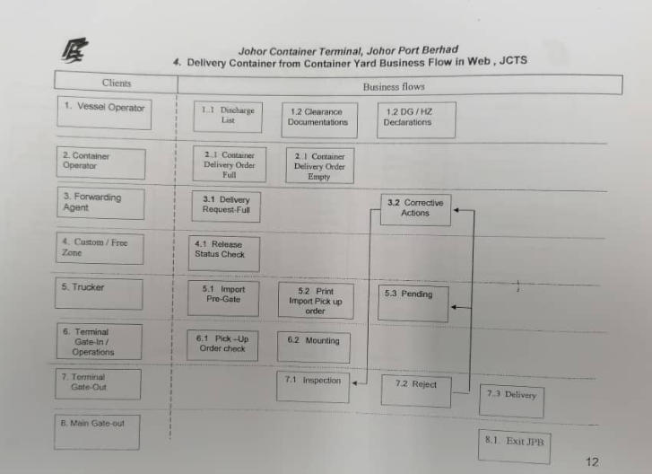
PROCEDURES AT THE TERMINAL DURING THE EPIDEMIC PERIOD WITH THE EXPERIENCE OF MALAYSIA PORTS?
Forwarding Agent will do declaration in SMK (System Maklumat Customs).
Once Customs approved, it is linked to JCTS for release status.
Physical customs inspection at CEA area where the haulier will proceed to the scanner.
JPB Terminal did not experience any interruption during the epidemic period.

Slide 8
OBJECTIVE OF BUSINESS CONTINUITY MANAGEMENT (BCM)
To establish the work process during crisis of COVID-19 pandemic and other related issues upon the annoucement is made the Malaysian Goverment, Johor Port Authority and JPB Management.
To execute the Business Continuity Management (BCM) for Container Terminal Department.
To activate the plan in ensuring Container Terminal Operations is function with reasonable interruption.
Pilot and lashing gang MUST be equipped with full PPE when onboard the vessel. Health Ministry has agreed to allow lashing gang not to wear a shoe cover due to safety reason when performing their works. However, they must sanitize their shoes when leaving the vessel.
Lashing contractor/related parties must get approval from port health/Health Ministry Pasir Gudang on type of full PPE to be used during the operation
No ship crew are allowed to disembark or roaming on ship deck. No face to face communication with ships crews as well.
Used PPE must be disposed through approved Department of Environment (DOE) contractor only.
Health Ministry / Port Health will deploy their staff to monitor the compliance of SOP. If found any incompliance, Health Ministry will issue Stop Work Order and vessel have to leave port area.
No ship crew allowed to disembark even for ship’s draft inspection
Stowage Plan approval or submission strictly via email.

Slide 9
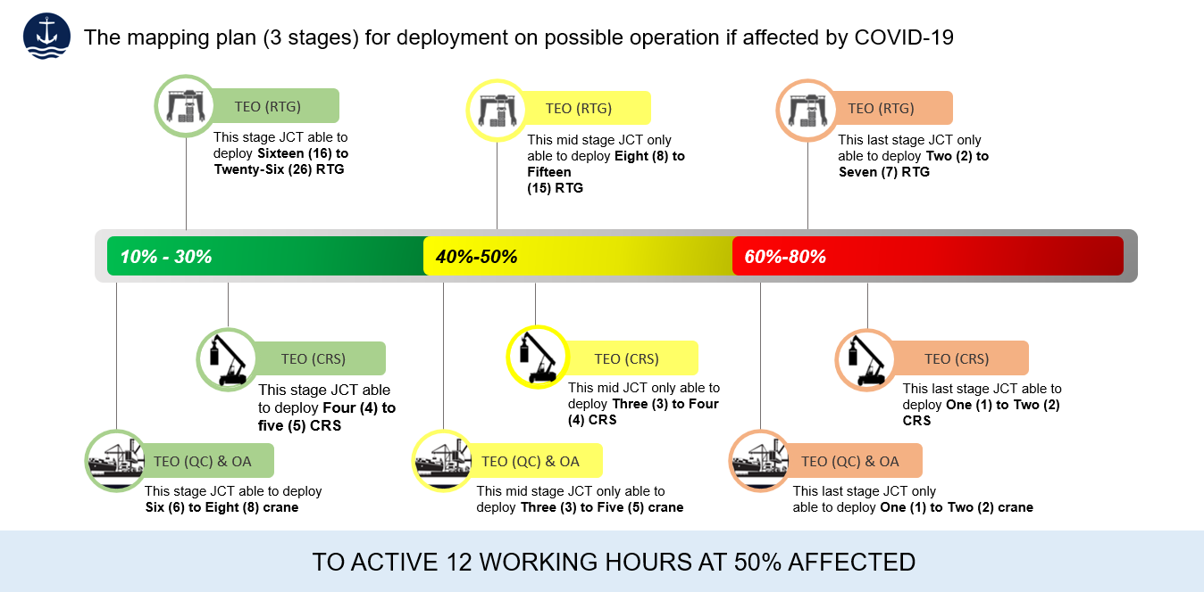
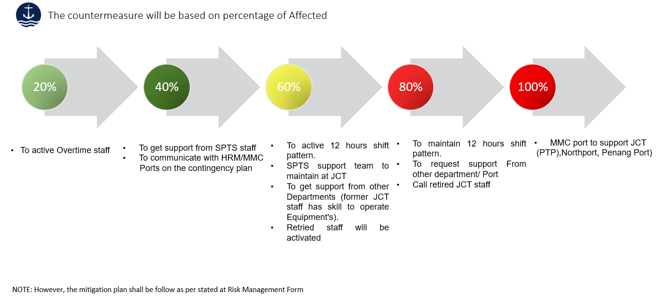
EXAMPLE OF BCM
The mapping indicate on the level of manpower availability.
Subject to # of staffs under quarantine, the Operations Management is able to determine the impact and activate potential contingency plan.
Escalation to Senior Management Team, in the event the cases reach 40%

Slide 10
STRATEGIES TO ADJUST OPERATIONS AND BUSINESS PLANS TO ADAPT TO THE NEW PERIOD
Improvement idea #
Topic
Addressed waste bucket
BMPH / GMPH impact estimation
1
Berthing
Berthing
Berthing / Planning
PM
Berthing
Dynamic Ops
Dynamic Ops
Planning
Commercial
Commercial
Dynamic Ops
Arrival Process
Departure Process
EDI / SI Submission
Shift Change
Vessel Exchange Time
Daily Operations Process
Shift Report
Yard Strategy
Lashing and Unlashing
Load plan approval
Focus Vessel
Waiting for Port Clearance / Load Plan approval
Port Clearance / Pilot Boarding Time
Improve Crane Planning Time
Crane Waiting Time
Reduce waiting time
Prioritization / Decision Making Empowerment
Decrease manual Intervention
Decrease crane waiting time
QC Idling Time
QC / PM waiting time
Increase Focus on bigger call size vessel
5%
2
3%
3
0.2
4
0.5
5
N/A
6
N/A
7
N/A
8
0.5
9
0,2
10
0,2
11
N/A
Example of strategies to manage day to day operations and processes redesign

Slide 11
Thank You

